Slide 1

The Evidence Challenge
Evidence-based practice sounds great … but it isn't easy.
Notes:
Easy to come up with stories about initiatives that failed because they were not based on solid evidence -- but leaders' intuitions. But we can also come up with stories where change was based on good evidence -- incontrovertible cost savings from outsourcing -- but failed dramatically.

Slide 2

The Case for Evidence
Pattern Recognition
Disciplined Thinking
Accumulated research reveals patterns invisible to any individual case.
Evidence forces us to ask: How do we know this? What would change our mind? Where might we be wrong?
Systematic reviews can show what consistently works.
Defensibility
When challenged, "This aligns with research across 50 organisations" carries more weight than "I've seen this work before."

Slide 3







The Six As of Evidence-Based Practice (Briner)
Ask
Acquire
Appraise
Aggregate
Apply
Evidence-based practice is hard — without clear questions and appraisal, cannot just do what the studies say.

Slide 4
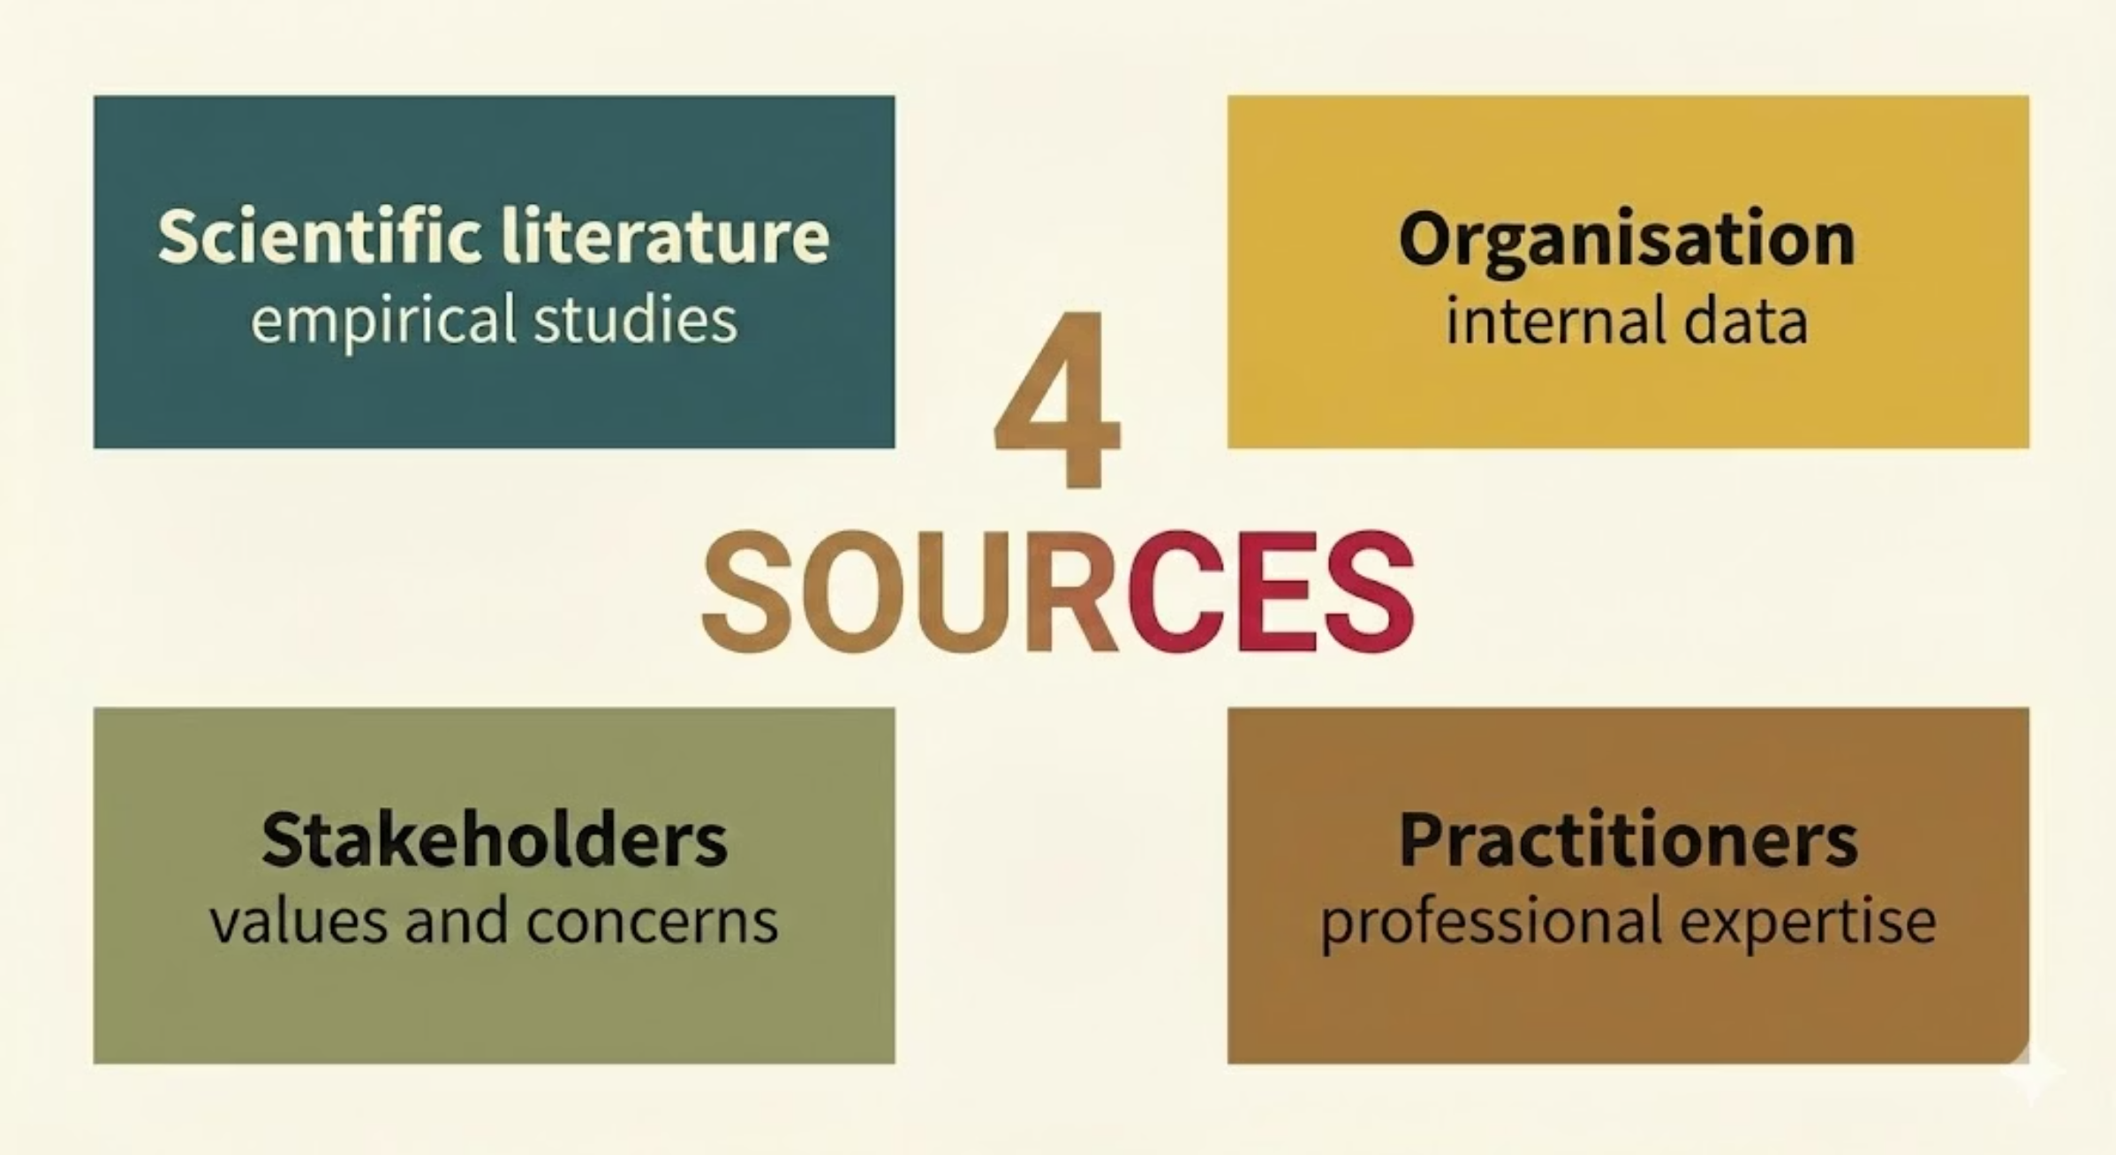

What is evidence?
Evidence-based practice requires taking multiple sources seriously. Not just academic research — but including it.

Slide 5
When Evidence Gets Ignored
Scared Straight Programmes
Open-Plan Offices
Taking at-risk youth to visit prisons to be confronted by inmates. The intuitive logic seemed obvious.
Research since the 1970s has typically shown they harm productivity and wellbeing. E.g. face-to-face interactions actually dropped 70% when companies switched to open layouts (Bernstein & Turban, 2018).
Systematic reviews showed they actually increased reoffending rates (Petrosino et al., 2013).
Nevertheless, got exported from US to UK, and continued long after harm was clear.
Yet companies continue implementing them. Why? Cost savings? A narrative about collaboration that feels intuitively true? Or scientists getting it wrong?

Slide 6


Internal Evidence Ignored
Kodak
Nokia
Invented the first digital camera in 1975. Management responded with "curiosity and scepticism," seeing it as "a very scary look at what could be possible."
Internal analysts recognised the iPhone threat immediately. A nine-person team warned that the iPhone's touchscreen could become "a new standard" and recommended Nokia develop its own.
They filed for bankruptcy in 2012.
Leadership didn't act. Then Nokia got bought by Microsoft …
Blockbuster
Turned down Netflix for $50 million in 2000, dismissing it as a
"very small niche business." Netflix is now worth over $340 billion.
Such case studies obviously suffer from hindsight bias!

Slide 7




The Bandwagon Effect
Organisations often adopt the same "evidence-based" practices,
becoming more similar (isomorphism).
Mimetic Isomorphism
Normative Isomorphism
Under uncertainty, organisations copy what successful peers do
Professional training, networks and consultants spread "best practices"
Coercive Isomorphism
Regulations and powerful stakeholders mandate compliance
Consider management fashions: Balanced Scorecards, Six Sigma, Agile. Each with evidence of success somewhere, not appropriate everywhere.
Fatal when the evidence is weak (“subprime mortgages are a good safe business!”)

Slide 8

Whose Success? What Timeframe?
"Evidence clearly shows that this practice contributes to success!"
For whom? According to whom?
An intervention might show positive results for shareholders whilst harming workers. Efficiency might improve whilst commitment declines.
And timeframe matters profoundly. An intervention that looks brilliant at six months might fail at three years.
Evaluation becomes harder over time — practically and empirically. Yet in theory, clients care about long-term value.

Slide 9

Policy-Based Evidence
Leaders decide what they want to do, then request the facts to justify it.
Surveys of managers consistently find that most make decisions based primarily on personal experience. Research articles rarely get read.
Dangerous tendency to cherry-pick research that backs up a pre-existing perspective and ignore research that challenges it — because appraisal is hard.
This isn't surprising — but is where consultants can add value.
"Policy-based evidence" is a risk for consulting too — but undermines the value proposition.

Slide 10

The Case Against Evidence-Based Management
Not everyone is convinced that evidence-based management is the answer — see Morrell and Learmonth.
Narrowness
Positivist Outlook
Misapplied Medical Metaphor
Evidence-based management risks privileging what can be measured over what matters, reducing rich organisational life to quantifiable metrics.
It promotes a worldview that misses important qualitative dimensions—meaning, interpretation, politics, power.
Organisations are more varied, contested, and political than medical contexts. The evidence-based medicine model may fundamentally not translate.
Their alternative: intellectual pluralism and openness: what they call "management learning."
Are they attacking a straw-man or a steel-man? (Also, which one shows up in practice?)

Slide 11


Context Matters
Something that works brilliantly in one setting may fail catastrophically in another.
The Case of Performance-Related Pay (PRP)
PRP can boost performance in simple, measurable tasks (e.g., manufacturing, sales).
However, it can backfire in complex, creative work (e.g., R&D, teaching), where it can undermine intrinsic motivation and collaboration.
Other interventions might depend on power distance, employee skill levels, trust, …
This highlights why "aggregate" in the Six As matters — multiple sources help understand boundary conditions.
Just importing "best practices" is very risky — especially if they might just have a halo of success. Theory matters!

Slide 12

Holding the Tension
Evidence-Based Practice Offers Value
But Has Real Limitations
Reduces reliance on gut feeling and management fashion
Provides defensible basis for recommendations
Forces explicit consideration of what we know and don't know
Systematises learning from accumulated experience
Not everything important is easily measurable
Context profoundly shapes whether findings apply
Values and politics legitimately shape decisions alongside evidence
Power dynamics influence what gets studied and shared
The best consultants hold the tension: Rigorous and humble.

Slide 13
A Practical Stance for important decisions
01
02
03
Consult All Four Sources
Exercise Contextual Judgment
Maintain Ethical Awareness
What does scientific research say? What does the organisational data show? What do experienced practitioners know? What do stakeholders believe and value?
Given this client's specific situation, constraints, and culture, does the evidence apply? What contextual factors might matter? How can we test that?
Whose interests does this recommendation serve? What values are embedded in how success is measured? What might be overlooked?

Slide 14
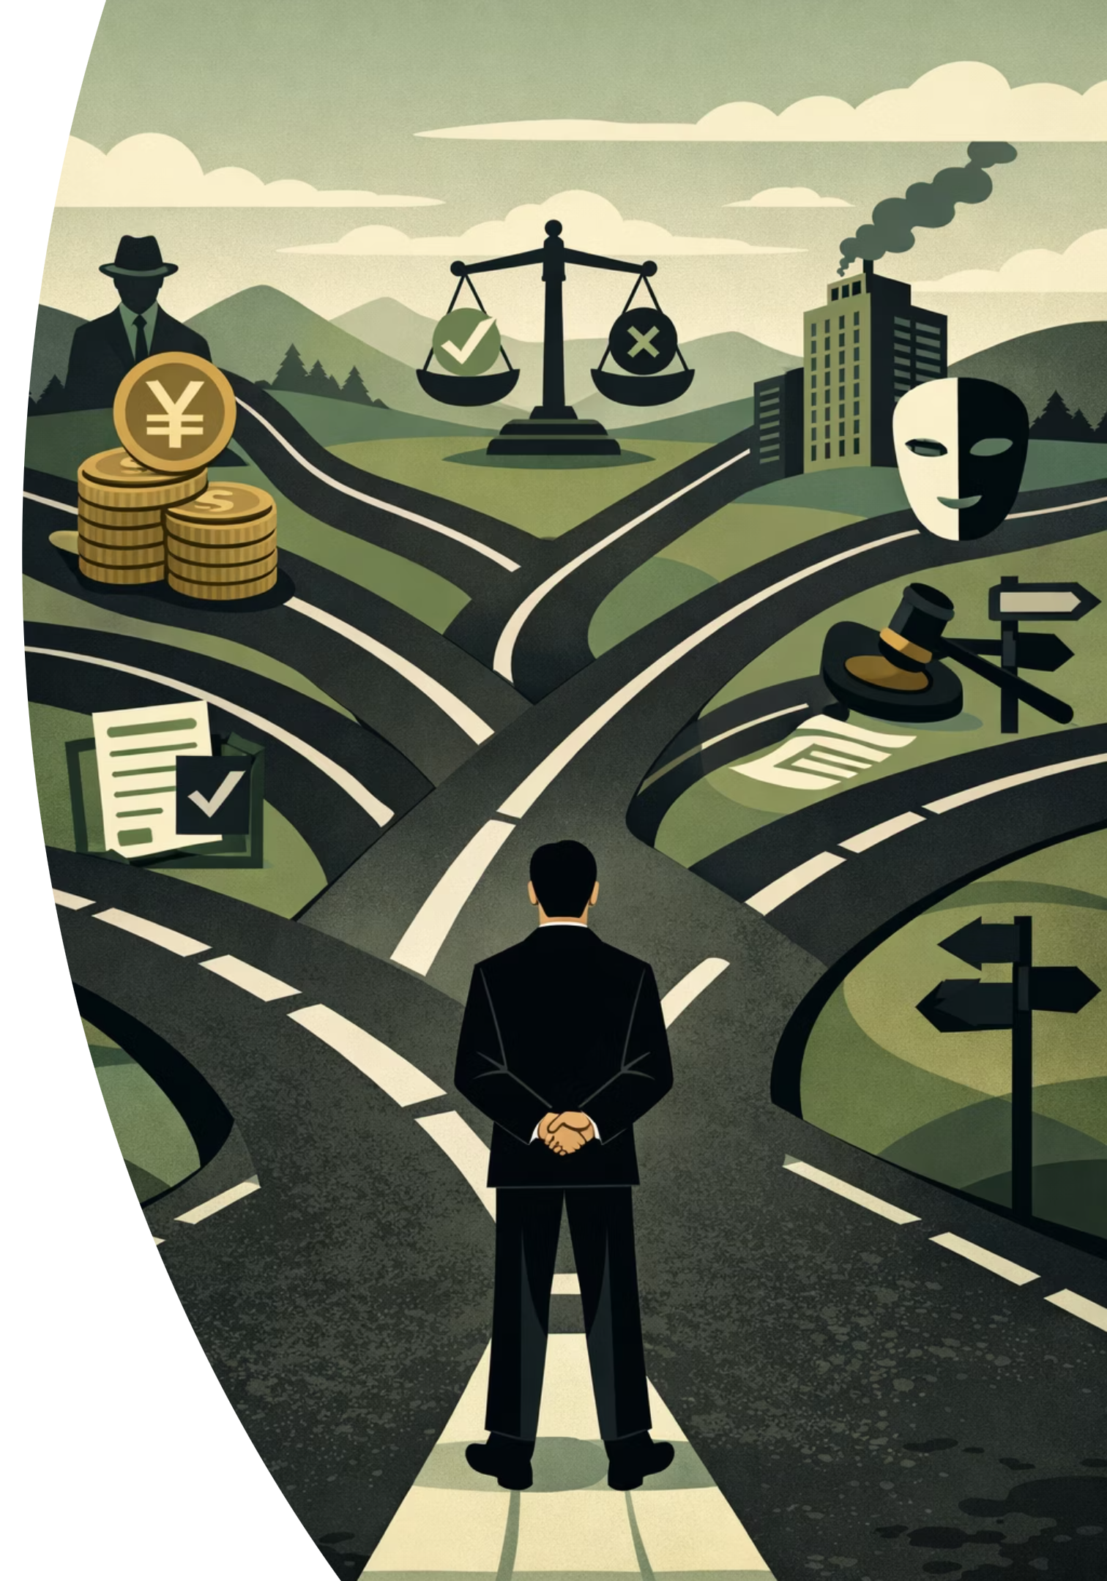
Reflection prompt: Think about evidence that informed a decision you made recently—at work or in life. What types of evidence did you consider? In retrospect, did you weigh them appropriately?
Decisions that matter
We've explored how to approach problems, how to design solutions, how to include evidence — one crosscutting dimension still needs to be discussed.
NEXT RECORDING
Ethics in Consultancy

